Slide 1
Film Documentary

Slide 2
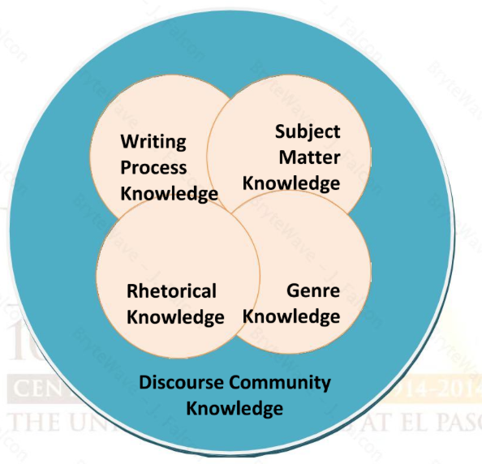
Why a Film Doc?

Slide 3
Writing Process
You have knowledge of the writing process
you are aware of not only your own process for writing, but essentially what you need to do to produce something that is effective
You’ve learned about genres, reaching an audience, rhetorical appeals

Slide 4
Subject Matter Knowledge
Use your sources
Find new sources
Use your knowledge of rhetorical appeals to determine if the source is credible, and/or
You’ve gained a great deal of knowledge about your topic throughout the semester.

Slide 5
Rhetorical Knowledge
Use rhetorical appeals
Ethos, Pathos, Logos
Think about audience and how it relates to purpose
Have a clear purpose

Slide 6
Visual Rhetoric
Using images to create meaning or construct an argument
Visual thinking
Visual learning
Visual communication
Multimedia approach for advocacy
Arrangement

Slide 7
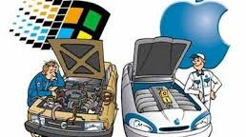
Examples

Slide 8


Slide 9


Slide 10
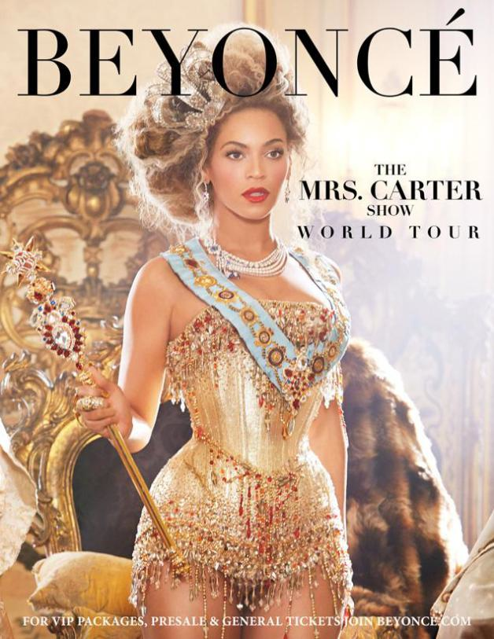

Slide 11
Multimodality
Multimodal – using different modes to communicate and express oneself
Mode – communication channel that a culture recognizes
Multimodal composition - uses more than one modality to achieve its intended purpose. The modalities are “visual, audio, gestural, spatial, or linguistic means of creating meaning” (Selfe, 195).

Slide 12
Assignment Details
Work in groups
Clearly advocate or promote awarenes
Advocacy - Public support for or recommendation of a particular cause or policy
Create an outline
Support claims
Be specific

Slide 13
Specific Assignment Guidelines
Doc must be 5 – 7 minutes long
Publish on YouTube or vimeo
Introduction
Support your claims
Include original and existing film, narration, images, sound
Be aware of technical aspects
Include a Fair Use Statement

Slide 14
Rubric – 200 Points p. 293
Purpose
Research quality, integration, relevance
Ethos
Pathos
Logos
Use of multimedia
Scripting, editing, timing
Credits

Slide 15
Examples
http://vimeo.com/65265214 Sugar Substitues
http://vimeo.com/56054347 The High Life
http://filmfestival.uglc.utep.edu/?p=814 Female athletes
http://filmfestival.uglc.utep.edu/?p=876 Whaling

Slide 16
What is the purpose?
Who is the intended audience?
How did they use images, video and sound?
What rhetorical appeals did they use? How? Why?

Slide 17
Class Activity
Get in Film Doc Group
Watch one of the examples
Analyze it, then grade it using the rubric
Explain your analysis, and grade
Due at the end of class

Slide 18
Outline
Outline Due Monday night

