Slide 1
E-Portfolio

Slide 2
Final Portfolio Checklist
Genre Analysis Revised
Genre Analysis Reflection
Lit Review Revised
Lit Review Reflection
Documentary
Documentary Reflection
Op-Ed
Semester Reflection

Slide 3
GA & GA Reflection
Your GA needs to be revised. This means that you should work on the areas of your paper with lower scores on the rubric.
Common areas that need work are supporting details, and specific examples, in-text APA citation, and APA format.
GA Reflection does not need to be revised. Simply include it.

Slide 4
LR & LR Reflection
Revise the LR based on what we discussed during conferences, if you did not revise for the final draft, and areas scored low on the rubric.
Common areas that needed work are APA in-text citation, including an image, explaining and introducing your primary research.
Include the Reflection.

Slide 5
Doc Link
Include your Documentary.
Do not post the link. Embed the video.
Include the Reflection

Slide 6
OP-ED
Include your OP-ED
You do not need to revise this assignment

Slide 7
E-Portfolio Guidelines
Include all of the assignments, and reflections previously mentioned.
Each paper and reflection MUST be a separate page/post on your Tumblr or website. You have the option of using Tumblr when putting together your portfolio or creating a website by using weebly, or whatever you prefer.
Adapt your papers for an online audience. This means breaking them up, adding more images, etc. Think back about some things we discussed during your conference.
Appeal to your intended audience. Remember that this is intended to be a website that people can visit to gain information about your topic and learn more about what you are advocating.

Slide 8
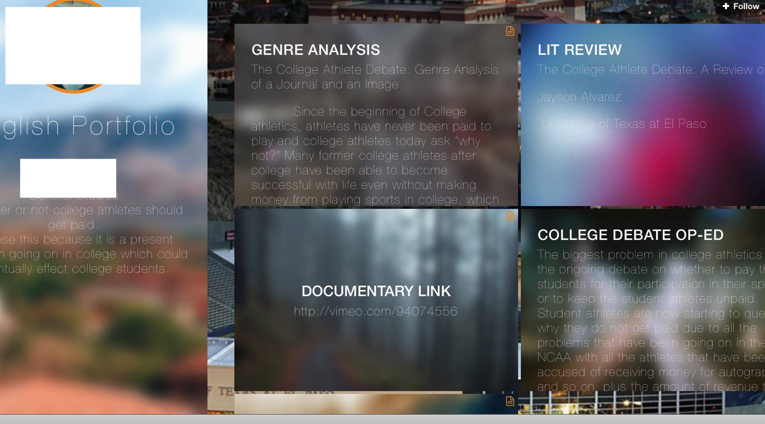
Here is one way you can use Tumblr to create your Website

Slide 9
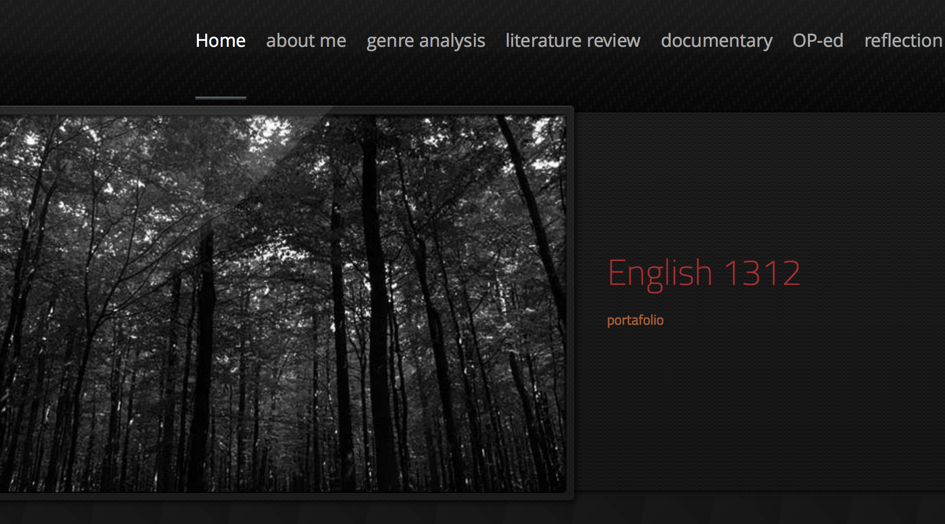
If you make a webpage, then each assignment must be a link.

Slide 10
Each assignment should be an individual post, or link, depending on if you make a website or use tumblr.
To change the layout of your Tumblr go to “Themes”
Good luck! As usual, you can call, text, email, if you have a question.
Website is due 12/7 11:59 p.m. via blackboard

Slide 11
Semester Reflection
The last Reflection you will compose will be an overall reflection. It must be 300 – 450 words. Here are some questions to guide your Semester Reflection.
What were your writing goals when the semester began? Did you achieve those goals? Did you have writing goals?
What area of your writing do you feel you improved the most?
Which assignment did you enjoy the most? Why? Did it help improve any aspect of your writing?
Why do you think we discuss the audience, purpose, use of ethos, logos, and pathos, when discussing writing and/or written works?
What did you learn in this class that you think you will use in other classes you take in the future?
Describe your experience and/or understanding of the tumblr posts. What did you like about them? What didn't you like? How were they helpful?
Please, be honest, whether you love the class or hate it, this is your space to reflect honestly on the assignments, and your work throughout the semester. As with other reflections you can include images, gifs, video clips, etc. This should be more extensive than our previous reflections, but include when/if you can different modes (images, gifs, video, etc.)

