Slide 1
Genres & the Genre Analysis

Slide 2
What is a genre?
Genre - a category used to classify discourse by form, technique or content.
A genre changes discourse through the way it presents information.
Presentation = construction, so when you look at the way something is presented you have to also think about how it was constructed (made)

Slide 3
Why do we study genres?
to better understand what our audience expects
to use the genre to communicate/write/compose to the best of our ability
to be aware of any limitations a genre may put on our writing

Slide 4
The e-book breaks genre into three categories
Oral - Public speaking, podcast, radio show/program, class lecture, interviews
Typography - : books/textbooks, magazines, newspapers, websites
Iconography - webcast, video, media, posters, cartoons/comics, photography, instruction sets

Slide 5
Genre Analysis
To complete the assignment you need to choose 2 DIFFERENT genres.
Don’t choose two images. Don’t choose two oral genres, or two that fall under the classification of typography.
The overall point of the assignment is for you to analyze two different genres. Why? In looking at how each genre relays its information you will gain a better understanding of the way each has to be constructed based on the limits/freedoms of its genre

Slide 6
So let’s say my topic is feminism and pop culture. I’m going to focus on Beyonce. I’m going to research this topic. In order to learn about it I’m going to look at an image and a website.
My genres are the image and the website.
Keep in mind that my topic isn’t a particularly specific at this point, but for class I’ll use it an example.

Slide 7
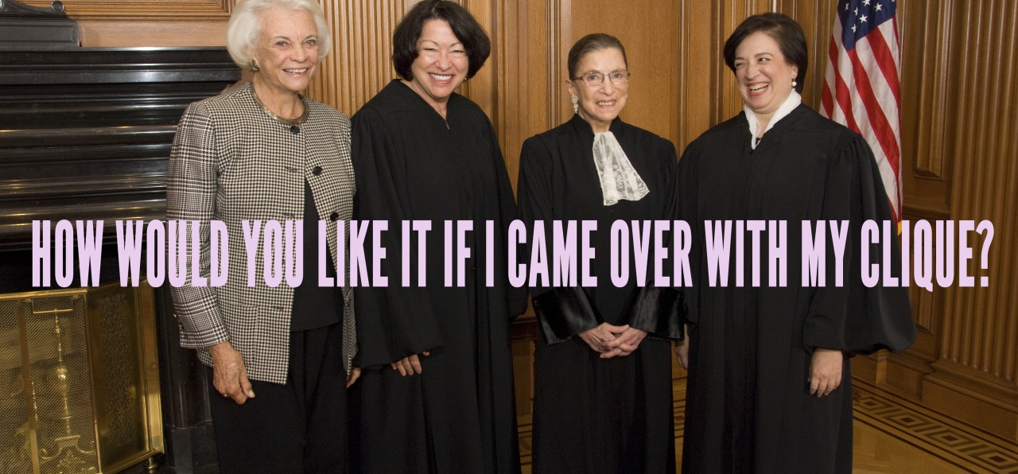
Image http://beyoncevoters.tumblr.com

Slide 8
Study the image. Pay attention to the details. Now go back to your assignment sheet and try to answer as many of the questions as you can.
What is the purpose of that image? Who is the audience?
How does it establish credibility?
Those are only a few of the many areas you need to address in your analysis

Slide 9
What specialized vocabulary is used?
How is the information organized to convey its message?
Are there limitations placed on the information because of the genre?
Does it have more freedom to express what it needs to because of the genre?

Slide 10
Article
I’m going to read this article, and answer the same questions.
http://womensenews.org/story/cultural-trendspopular-culture/141016/why-im-not-buying-beyoncés-brand-feminism

Slide 11
These are two different genres, with different purposes, and audiences.
They have different limitations
The point of this assignment is to analyze each genre, to look at the ways in which each genre constructs its message/purpose, and presents it to its audience.

Slide 12
Analysis
How do I analyze a genre?
The best way to go about this is to pay close attention to the assignment sheet in the guide. The questions there will help you in your analysis.
On the following slides I’ve come up with an example that is not related to any of the work you all are doing in the class

Slide 13
Some Tips
Organization will go a long way in your writing, especially in this class.
Your draft should somewhat resemble this format.
Intro – In your intro you do just that. Introduce the topic of the genres. Provide important information for each genre (author, type of publication, etc.)
Audience & Purpose – Clearly state the intended audience and purpose for each genre. How much time does it take? Special language?
Ethos, Pathos & Logos – as the list of questions won’t fit here
Structure & Delivery – How is the information shaped by the genre? Do you get more information out of the text or the image?
Conclusion/Synthesis – Which genre is more effective in conveying its message?

Slide 14
More Advice
The biggest advice I can give to you is to closely follow the assignment sheet. It should become your best friend while you work on this paper.
Use it as a checklist to make certain that you’ve addressed all the areas you need to in your analysis.
Don’t argue a point. Don’t use the first person. Don’t give an opinion. Don’t summarize the article, website, image.
This is not a report. You are not relaying information about the topic to your reader. You are demonstrating to your reader the knowledge you have about how a genre shapes discourse

