Slide 1
Annotated Bibliography

Slide 2
Annotated Bib
Due 3/5 at 11:59 p.m.
Must be in APA format
The LR must have 8 to 10 sources
Your AB must have at least 7 sources
You must use a variety of sources

Slide 3
Variety of Sources
All of your sources must be credible, and I trust that by this point you know when something is credible and when it is not.
If you have questions about a source, talk to me about it.
Most of your sources will likely be scholarly articles, but all 8 to 10 should not be only these types of articles.

Slide 4
Variety of Sources
Other types of credible sources can be websites, videos, magazines.
I usually don’t recommend newspaper articles because they tend to be short and therefore don’t contain a lot of infomration
Credible websites & videos can be from credible organizations and/or government agencies

Slide 5
Annotated Bib Guidelines
7 – 10 sources
7 – 10 sentences
APA format
4 to 5 sentences of main points, relevance, importance of the source.
2 to 3 sentences explaining relevance of the source to your LR.
1 sentence explaining which question the information in the source will help answer

Slide 6
AB Assignment Guidelines
At the beginning of your AB I would like you to include your revised research questions
This will allow me an opportunity to read through your revised questions, and your sources

Slide 7
To Review
7 – 10 sentences per source!
So, 7 – 10 sentences for 7 to 10 sources
Include revised research questions

Slide 8
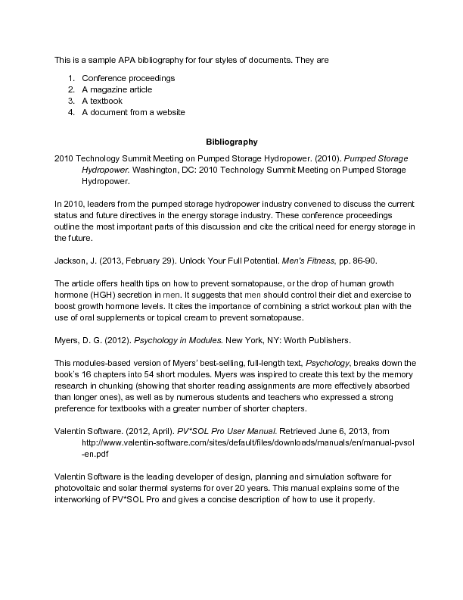
What does it look like?

Slide 9
What does it look like?
Questions numbered at the top
APA citation, like in your Reference page
Below each citation will be your annotations (sentences)

