Slide 1
E-Portfolio

Slide 2
What to include
GA
GA Reflection
LR
LR Reflection
Doc or DSA
Doc or DSA Reflection
OP-ED

Slide 3
Arrangement
All assignments must be in chronological order
The list on the previous slide is how they should be arranged on your website or tumblr
Start with the GA, and end with the OP-ED

Slide 4
Adapting Papers for an Online Audience
Because this is an e-portfolio and accessible via the internet you must appeal to an online audience
The only papers that need to do this are the GA and LR.
To do this add pictures to the GA. If you analyzed a poster or image in your GA include it in your paper.
For the LR, add more than the required one image, if it is appropriate.
Break the papers into different pages or posts.

Slide 5
Adapting Papers for an Online Audience
Why break up the papers into separate pages and posts?
An online audience doesn’t read 4 t 10 pages of text on one page. To be effective in delivering your message you need to think about what your audience expects.
They don’t expect to read several pages of text with little or no images. An instructor may expect that, but you need to think of an audience other than me.

Slide 6
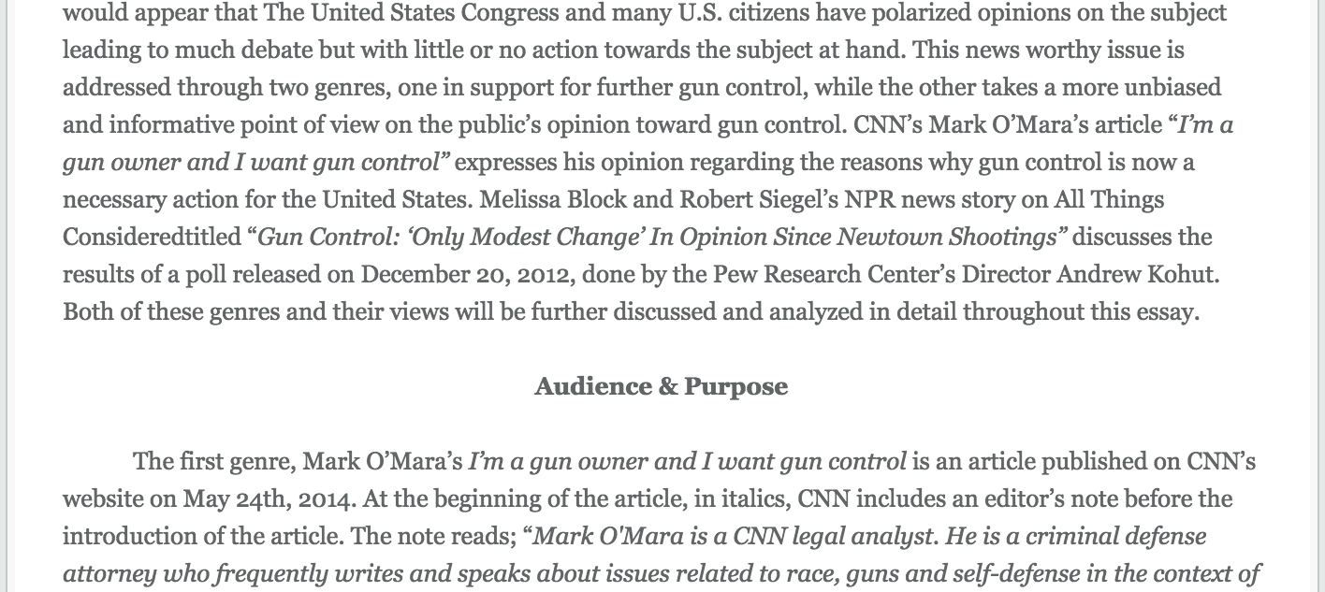
Adapting Papers for an Online Audience
This is what I don’t want.
Add images to your text.
Make it visually appealing.
Don’t copy/paste your papers.
You will not earn a good score
if you copy/paste your papers.

Slide 7
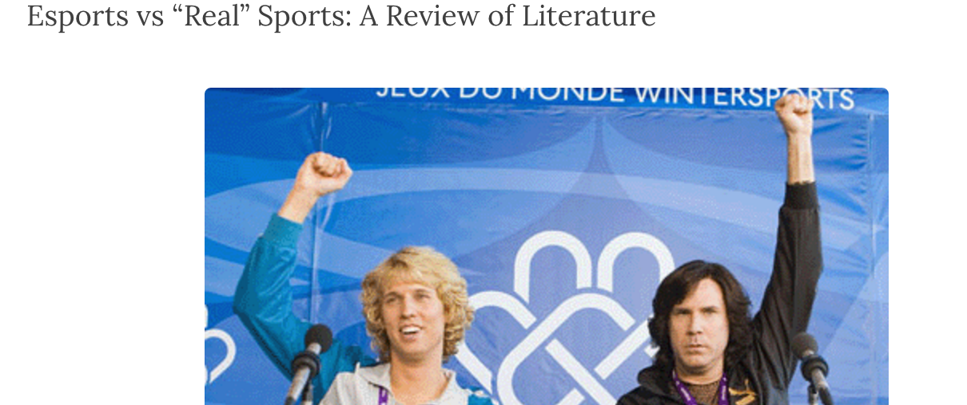
Adapting Papers for an Online Audience
This student broke the LR
into separate posts. They also
added images that were
appropriate for their topic.

Slide 8
Adapting Papers for tumblr
If you choose to use tumblr for your e-portfolio break the paper up into several posts, as you see fit.
Students typically break the GA into an intro, analysis, and conclusion. They add images when/where they feel it is appropriate.
The LR can be broken up by intro, research questions (each question is a post), and conclusion. Add more images if you can.

Slide 9
Adapting Papers for tumblr
If you use tumblr I recommend making a new tumblr blog, and submit the link to me
Why? It can be confusing moving posts around, and you don’t want to delete any of your previous tumblr posts.
Why? If there is an issue with your grade you don’t want to delete your work. A good rule is to keep the work you submit for at least a year.

Slide 10
Adapting Papers for a Website
Using a website is also an option. You can use weebly, wix, or another site you feel comfortable with.
Make each assignment a separate page on your website.
All links should work.
Do not simply upload your Word doc. You need to adapt the papers for an online audience.

Slide 11
About Me
Include an About Me section. This must be done whether you use tumblr or make a website.
Do not use a website from 1301, or something you need in another class. Create something new.
Your about me section should include your first name only, major, semester topic and why you chose to research it

Slide 12
Answer the following questions in your Final Reflection
The last Reflection you will compose will be an overall reflection. It must be 300 – 450 words. Here are some questions to guide your Semester Reflection.
What were your writing goals when the semester began? Did you achieve those goals? Did you have writing goals?
What area of your writing do you feel you improved the most?
Which assignment did you enjoy the most? Why? Did it help improve any aspect of your writing?
Why do you think we discuss the audience, purpose, use of ethos, logos, and pathos, when discussing writing and/or written works?
What did you learn in this class that you think you will use in other classes you take in the future?
Please, be honest, whether you love the class or hate it, this is your space to reflect honestly on the assignments, and your work throughout the semester. As with other reflections you can include images, gifs, video clips, etc. This should be more extensive than our previous reflections, but include when/if you can different modes (images, gifs, video, etc.)

Slide 13
To Review
E-Portfolio = tumblr blog or a website (you choose)
All major assignments and reflections (GA, GA Reflection, LR, LR Reflection, Doc or DSA, Doc or DSA Reflection, OP-ED, Semester Reflection)
About Me section
Papers adapted for an online audience.
Assignments should be in order of completion. Start with the GA, and end with your Semester Reflection.

Slide 14
Submission
Send me the link to your tumblr or website.
I will grade your complete portfolio.

