Slide 1
Visual Rhetoric and Multimodality

Slide 2
Visual Rhetoric
Using images to create meaning or construct an argument
Visual thinking
Visual learning
Visual communication
Multimedia approach for advocacy
Arrangement

Slide 3
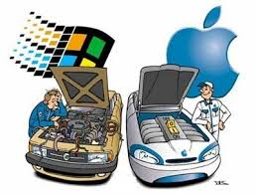
Examples

Slide 4


Slide 5
Discussion Questions
Choose 1 one of the images in this powerpoint and answer the following questions.
What is the message? Is it persuasive or informative?
How do you know what the intended purpose is? (refer to the image to explain your answers. Be specific in using examples from the image to explain your analysis)
Who is the intended audience?
What makes this effective? What makes it ineffective?

Slide 6
Multimodal Compositions
For a large majority of our tumblr posts you will be required to construct multimodal compositions
Before you can begin composing in multiple modes (multimodal) I will introduce and define multimodal compositions

Slide 7
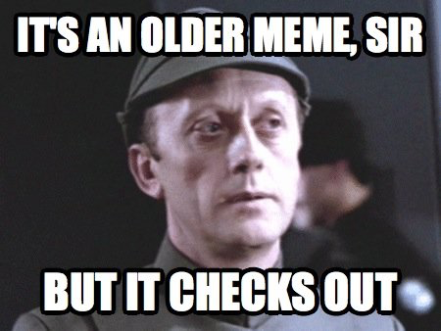
Multimodality
Multiple modes, or mixing modes
Mode - According to Kress a mode is a “socially and culturally shaped resource for making meaning.”
Memes are multimodal text
Multimodal goes beyond text

Slide 8
Multimodal Compositions
The image on the previous slide is an example of a multimodal composition because it mixes modes. There’s an image (one mode) and text (also a mode).
Films are multimodal. They incorporate video, which a moving image and sound.
You see this often with animated gifs that include text. I’m sure you’ve all seen this, or memes. Those are multimodal compositions. You can use them to compose and communicate a message. What you use, and how you use it is up to you.
If this is new terminology to you, don’t fret. At this point I want you to understand the definition, and be able to identify multimodal compositions.

Slide 9
Why is this important?
It’s important to recognize multimodal compositions, and compose them yourself, because of our constant exposure to these types of compositions.
As with text only writing, it is also important to think of audience, intended purpose, delivery, etc. to compose and communicate effectively.
The majority of the multimodal compositions in this class will be fun, and aimed at helping you to understand, or work through, where you are with an assignment/concept.

Slide 10
Online Assignment Week 1
Compose a multimodal post on Tumblr.
Introduce yourself. Be multimodal; not just a text. Find a way that best represents you.
For an example, go to falconrws1302.tumblr.com
      or villaphd.tumblr.com

