Slide 1
tumblr

Slide 2
tumblr
tumblr is a multimedia social network blogging site
You will complete weekly tumblr posts
This powerpoint will help you set up your blog and act as a brief introduction to tumblr

Slide 3
Setting Up Your Account
Go to tumblr.com
Enter an email address, your preferred blog name, and sign up

Slide 4
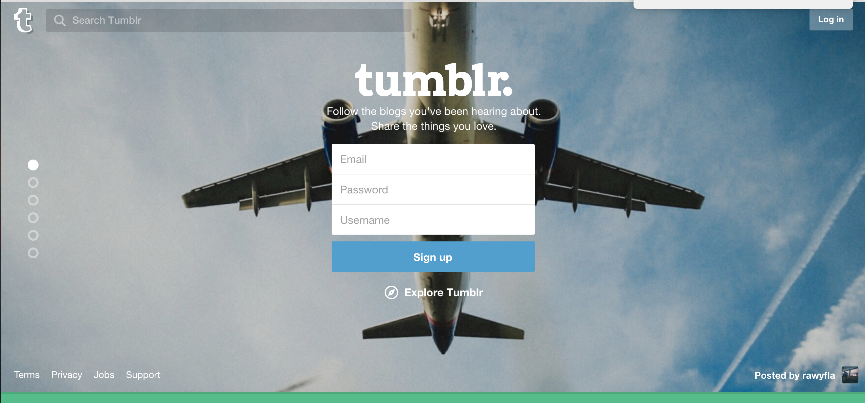
Screenshot of sign up page

Slide 5
Dashboard
The dashboard is similar to other feeds on social networking sites.
Everyone you follow will appear on your dashboard
At the top of the dashboard is a menu where you can choose what type of post you’d like to make

Slide 6
Following Blogs
My blog is falconrws1302. Follow me
Also follow jvillaphd, and audreyfay. These are two RWS 1302 instructors. They, along with me, will post helpful links, infographics, etc. throughout the semester
To follow me, or anyone type the blog name in the search bar in the upper left corner

Slide 7
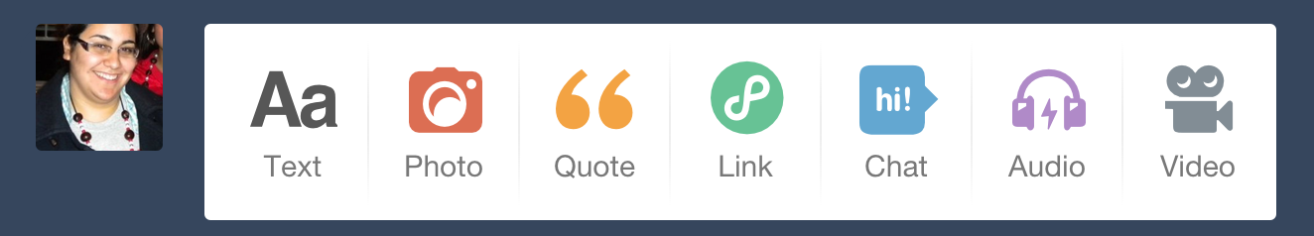
Dashboard screenshots
To post an image, click on photo, to post text, click on text, and so on.

Slide 8
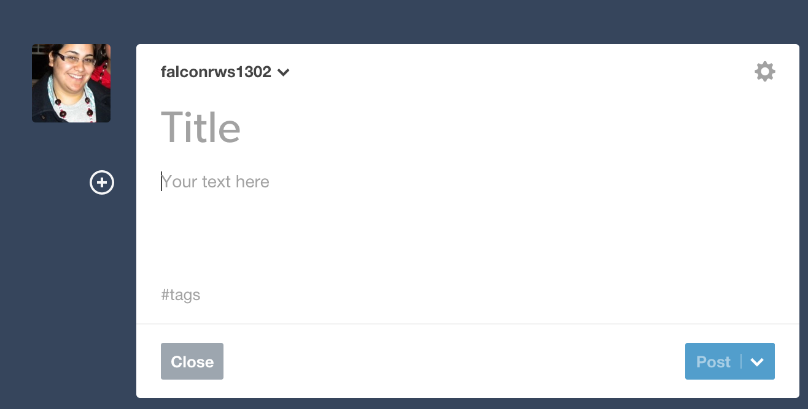
Text Post

Slide 9
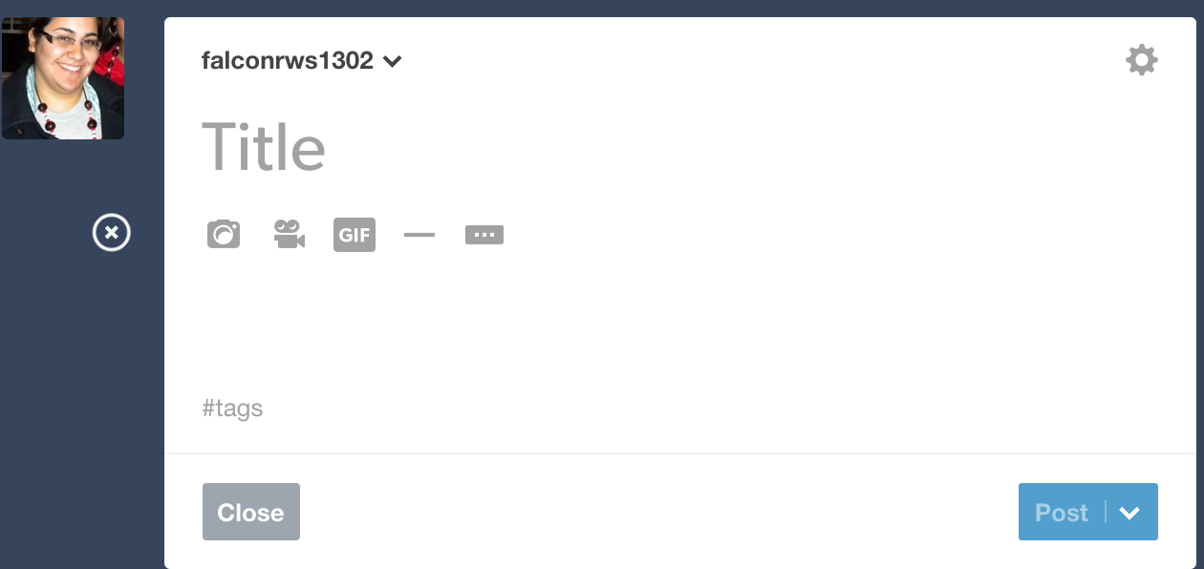
Adding an image to a text post

Slide 10
Text Post
Title all text posts
To add an image click on the + and upload a photo or gif, or paste a link to the photo/gif you want to add to your post
Advice! For your multimodal posts this will be one way to easily complete them.

Slide 11
Hashtags
Tag your posts! If you don’t tag your posts correctly.
All posts must contain the tag RWSJF, so that I can easily find your posts.
If other tags are needed I will provide them to you. You can use additional tags to reach a larger audience.

Slide 12
Hashtags
Tags are typed at the bottom of each post
Use a comma after the tag to begin another tag.
For example – rws16, RWSFalcon, these are now two separate tags.

Slide 13
Tumblr
You will complete weekly tumblr posts. The prompts will be on both blackboard and tumblr.
To receive credit for these assignments they must be completed before the deadline, contain the proper tags, AND you must send me a link to your post via blackboard.
Why send me a link? So that we both have a record of assignments completed for credit.

Slide 14
Sending me a link
After you post it will appear on your dash.
At the bottom of the post you will find different options. If you click on the 3 dots, select permalink.
This will give you a direct link to your post. Copy this link. This is the link to submit to me for credit.
Do not send me tumblr.com/dashboard or a link to your blog.
Your link should look similar to this http://falconrws1302.tumblr.com/post/134477298194/film-doc-reflection

Slide 15
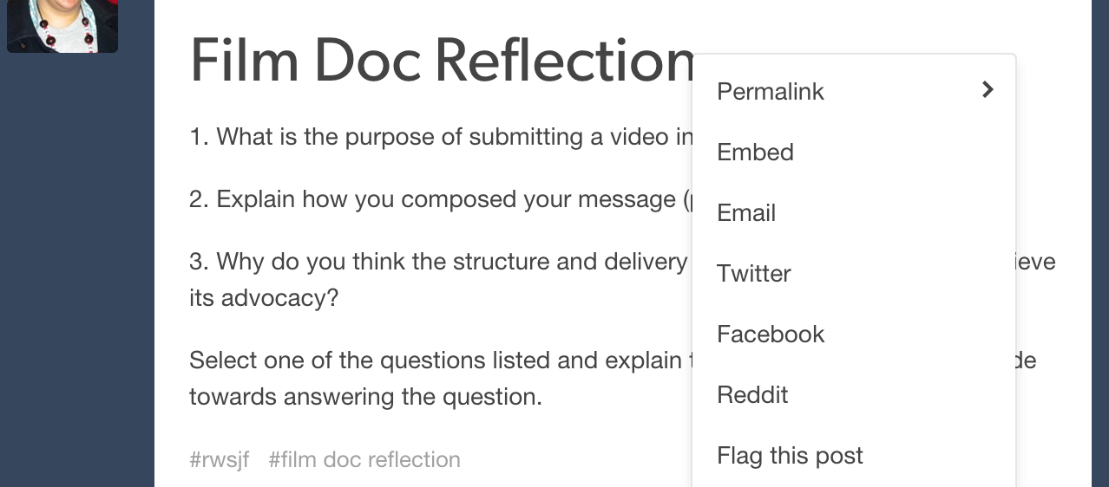
Permalink

Slide 16
Tumblr Conclusion
This may seem like a lot, or very easy depending on your comfort level with blogging.
We don’t meet face to face, so tumblr is our opportunity to discuss assignments, readings, and thoughts/concerns about assignments.
Have fun with it and if you have a question ask me. I’m here to help, but the goal is that we will all be able to assist each other.

