Slide 1
The Public work of rhetoric citizen-scholars and civic engagement
Edited by John M. Ackerman and David J. Coogan

Slide 2
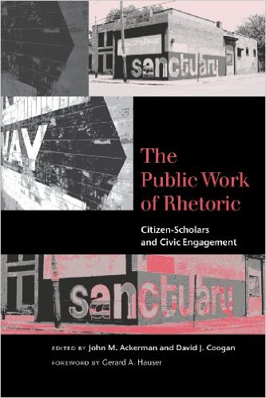
The Public work of rhetoric citizen-scholars and civic engagement

Slide 3
Edited collection by John M. Ackerman and David J. Coogan
Three parts
Rhetoric Revealed
Rhetorical Interventions
Remaking Rhetoric in Universities and Publics

Slide 4
The Public work of rhetoric citizen-scholars and civic engagement
Rhetoric discovering its usefulness
We live in times of strife
Call to do rhetoric “out there”
Do rhetoric out there → rhetoric going public
1. different professional disposition
2. Shedding of adornment of academics
3. New participatory and analytic tools
4. Ground conception of public need

Slide 5
The Public work of rhetoric citizen-scholars and civic engagement
Rhetoric should not deny itself
Not motivated by a particular agenda
“motivated by embodied practices that we have cultivated in relationship with people in our communities” (p.7).
Aims to present alternative narrative
Rhetoric of the “lost geographies” of public life that hold the political and ethical dimensions of real life
Accounts for a new disciplinary identity

Slide 6
Rhetorical Engagement in the cultural economies of cities
By John M. Ackerman
Civic engagement – accurately names rhetorical investments of citizen-scholar in public life of their cities
Policy realm and educational scene
Civic – harkens back to public life of rhetoric in the past
Scholarship engagement – Boyer defines as an attempt to connect “the rich resources of the university to our most pressing social, civic, and ethical problems, to our children, schools, teachers and cities” (78).

Slide 7
Rhetorical Engagement in the cultural economies of cities
The role of the university → turn to include engagement as a “vehicle to strengthen the collegiate experience” (78)
Universities remake themselves based on the demands of capitalism
Service learning contributes to free and/or replaceable labor
Intoned along global competitiveness and economic redevelopment

Slide 8
Rhetorical Engagement in the cultural economies of cities
Where and how does the citizen-scholar enter into policy spheres that influence the political and economic consequences of civic life?
How might rhetorical practice alter the linguistic, deliberative, and material terrain that a policy sphere presumes to address, particularly in postindustrial cities?

Slide 9
Kent, Ohio
Return to the city → frames rhetorical engagement in economic terms
Argues that if knowledge and information are the new currencies then they are shaped/remade in schools, offices, neighborhoods, etc.
All shaped by policy spheres → demonstrate the depth and breadth of overlapping policy areas
What issue must Kent, Ohio deal with and address?
Tragedy impacts development of city, as does lack of economic growth and competitiveness

Slide 10
What can we learn from Kent, Ohio?
Civic engagement as practice can’t escape its economic circumstances
Requires that rhetorical engagements return to the city
Understand discourses that shape public life
Rhetorical engagement as partnerships in economic development
Communities in constant dialectic with the global economy
Resist urge to analyze and critique and embrace new scholarship when possible
“we are wise to open our methods and dispositions to the economies of practice and culture outside of the academic.”

Slide 11
Connections to previous readings
Grabill and Simmons “Toward a Critical Rhetoric of Risk Communication: Producing Citizens and the Role of Technical Communicators”
Addresses problems community based participatory research
Increased public involvement in the decision making about risk
Additional knowledge → citizens role in contributing valuable knowledge
“Access means not only a place at the table, it means the rhetorical ability to participate effectively and the structured requirement that others listen” (427).

Slide 12
questions
Other themes and connections

