Slide 1
Multimodal Composition and Remediating Your Research
Jennifer Falcon
University of Texas at El Paso

Slide 2
Overview
Introduce modes of communication and multimodal composition
Discussion of multimodal composition
Examples of multimodal composition
Activity #1: Analyzing Multimodal Texts
Remediating Your Research
Sharing Your Multimodal Composition
Activity #2: Composing a Multimodal Project

Slide 3
Modes of Communication (Writer/designer: A guide to making multimodal projects)
Text - alphabetic text/words
Visual - images
Aural - sound
Linguistic - spoken communication
Spatial - physical
Gestural - body language, gestures

Slide 4
Multimodality/Multimodal Composition
A single mode can be used to communicate a message and/or deliver information
Using multiple modes to communicate and/or deliver information presents an opportunity to use all modes to reach an audience and achieve a purpose

Slide 5
Multimodal Composition
Can be defined as any text that uses one or more modes to communicate a message and/or deliver information
Often digital, but is not digital only.
Shareable and accessible to the public

Slide 6
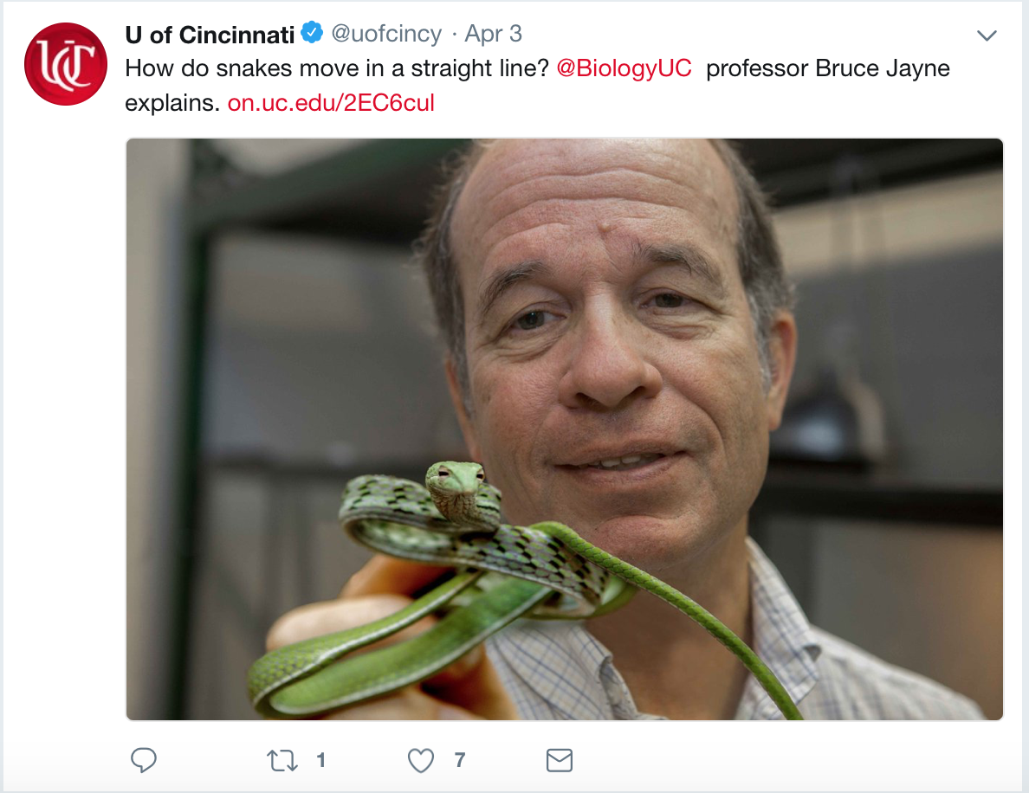
Examples of Multimodal Composition at UC

Slide 7
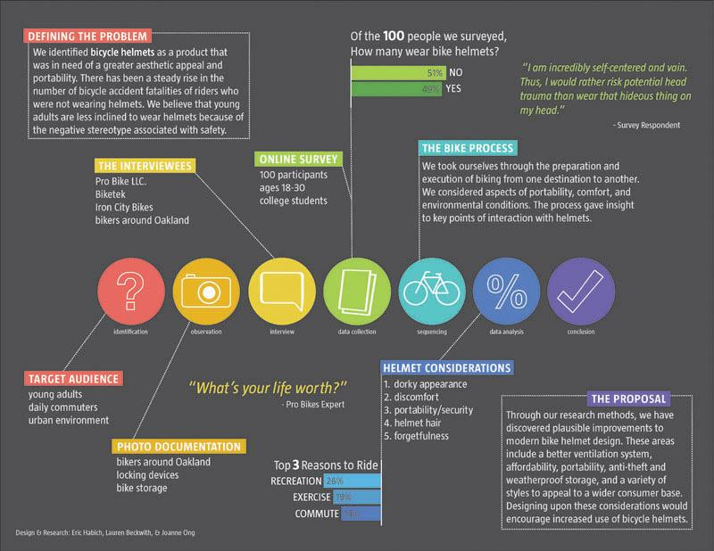
Research Poster

Slide 8
Activity #1: Analyzing Multimodal Texts
Groups of 3 or 4
Begin with general observations of this research poster.
What is the purpose of this research poster?
What modes does this research poster use? How does it use them?
What are the advantages and disadvantages of using these modes?
How is text used? How are visuals used?
How does the research poster arrange information?
What does the design and arrangement of information tell us about the audience?

Slide 9
Remediating Research/Informative Paper
Share with the public (non expert audience)
What do you want to do with your research or information you possess? (Purpose)
What does the public need or want to know about your topic? (Audience Analysis and Expectations)
What combination of modes work best to deliver your research/information? (Delivery)
Which modes are you most familiar and/or comfortable using? (Author Knowledge)
What platform best supports sharing your multimodal composition and reaches your intended audience? (Delivery)
How will you promote sharing your work? (Circulation)

Slide 10
Common Uses of Multimodal Composition to Share Research
Infographic
Research Poster
Flyer
Informational or Tutorial Video
Podcast

Slide 11
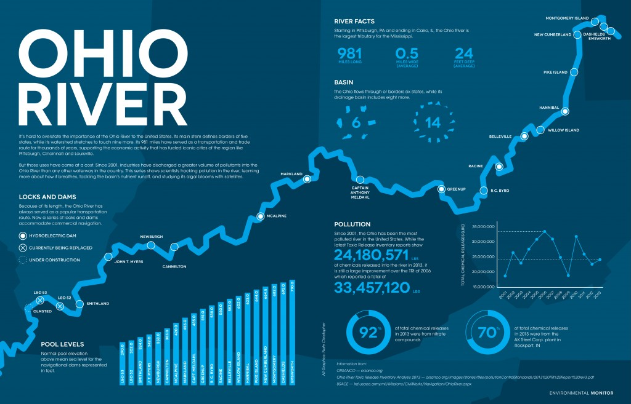
Infographic

Slide 12
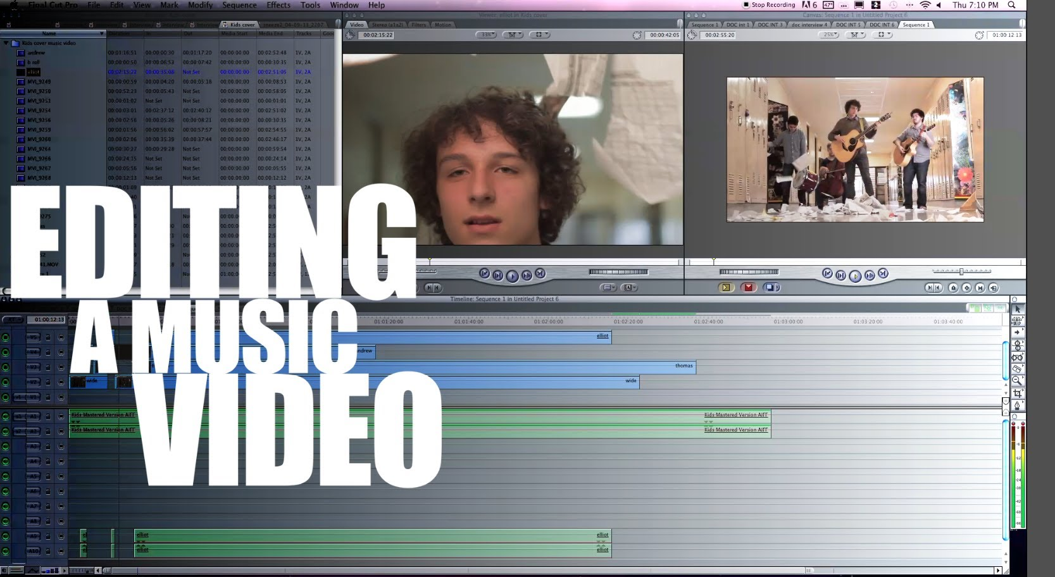
Tutorial

Slide 13
Activity #2: Composing a Multimodal Project
Think back to a paper you’ve written, or may want to write in the future and plan for 5-7 minutes about how you would make that paper multimodal.
What modes would be best to reach your audience and deliver your message/information?
What modes would you use? Why?
What programs/software do you need to compose this?
What information from your paper would you keep? What would you cut out?
How would you make this accessible to the public?
What platforms would you use to share it? How will you reach your intended audience?
If you need some help getting started, write a brief purpose statement.
My purpose is to ______, so that my audience will _______.

Slide 14
References
Arola, K. L., Ball, C. E., & Sheppard, J. (2014). Writer/designer: A guide to making multimodal
projects. Macmillan Higher Education.
Beck, Lauren (n.d.). Retrieved from http://blog.laurenbeckwith.net/bikehelmet.html
Kelly, Daniel (2015). Infographic: Ohio River. Retrieved from
http://www.fondriest.com/news/infographic-ohio-river.htm
Ramelan, Zach (2013). HOW TO: EDIT A MUSIC VIDEO (TUTORIAL). Retrieved from
https://www.youtube.com/watch?v=GrnuSJKaBAU

Slide 15
Planning a Multimodal Composition
Audience
Purpose
Combination of modes best suited for audience
Arrangement
Delivery
[Suggestion: then maybe you don’t need this slide? Then it won’t seem like you are talking too much/repeating because you already covered it??]

