Slide 1
Rhetoric & Technology Portfolio
Jennifer Falcon

Slide 2
Overview
Journal Analysis
Article Analysis
Book Review
Practice Comp Exam
Digital Project

Slide 3
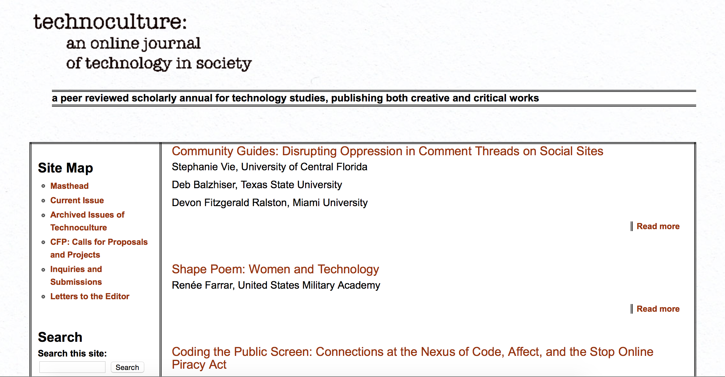
Journal Analysis

Slide 4
technoculture: an online journal of technology in society
Critical Essays
Creative Works
Note from the Editor
Interviews
Postscript
CFP

Slide 5
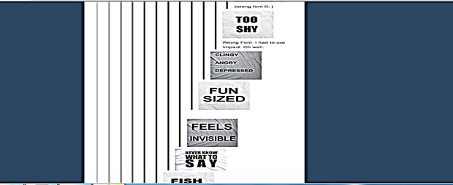
Article Analysis
Everything Old is New Again: A Barthesian Analysis of Tumblr
K. Shannon Howard, University of Louisville

Slide 6
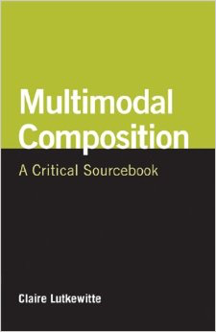
Claire Lutkewitte

Slide 7
Multimodal Composition A Critical Sourcebook
Part One – What Counts as Multimodal Composition and Why Does it Matter?
Part Two – A Matter of Design
Part Three – Making Meaning with Multimodal Composition
Part Four – Assignments and Assessment
Part Five – Building a Sustainable Environment for Multimodal Composition
Part Six – The Dynamic Nature of Literacy and Multimodal Compositions

Slide 8
Practice Comp Exam
The evolution of technology influences rhetoric and rhetoric studies in a number of significant ways. Select one or two (if two, they should be interrelated) topics from the list below and discuss how we’ve seen their concept/role/practice shift and how writing and rhetoric instruction has changed (or not) along with it.
Arrangement
Delivery

Slide 9
Digital Project
Video

