Slide 1
The Digital Self-Reflection: Metacognitive Practices through Multimodality
Jennifer Falcon

Slide 2
Metacognition Overview
D.J. Hacker (1998) states “metacognitive thoughts do not spring from a person’s immediate external reality” (2).
“Source is tied to the person’s own internal mental representation,” and ultimately “tied to the person’s own internal mental representations of that reality” (2).
Downing et al. (2009) suggest that “in order to effectively solve problems, students often need to understand how their mind functions” (610).

Slide 3
Reflection Assignment
address progress, and urges students to be critical of their literacies
asked to assess what they knew during the process of completing a composition, what they needed to learn to complete the assignment, and what they did to achieve that knowledge.
Yancey (1998) in her book Reflections in the Writing Classroom, views reflection in writing as a growth of consciousness, and a means of going “beyond the text to include a sense of the ongoing conversations that texts enter into” (p.5).
“student talk,” which she defines as a part of the reflection process that asks students to participate with instructors as active participants in their learning (Yancey). She defines reflection as a “processes by which we know what we have accomplished and by which we articulate accomplishment, and the products of those processes” (p.6).

Slide 4
Multimodal Compositions
The New London Group (1996) appeal to instructors to form new pedagogical practices based on the new multiliteracies to “broaden understanding of literacy and literacy teaching and learning to include negotiating a multiplicity of discourses” (p.61).
Selber (2004) built on the idea that we all function in a world where multiple digital literacies are necessary.

Slide 5
The Multimodal Self-Reflection
Continue the conversation of incorporating multimodal compositions in the writing classrooms
Multimodal making is writing
Using mixed media
Multiliteracies
Agency

Slide 6
tumblr
Tags
Discourse communities
Genre conventions and styles

Slide 7

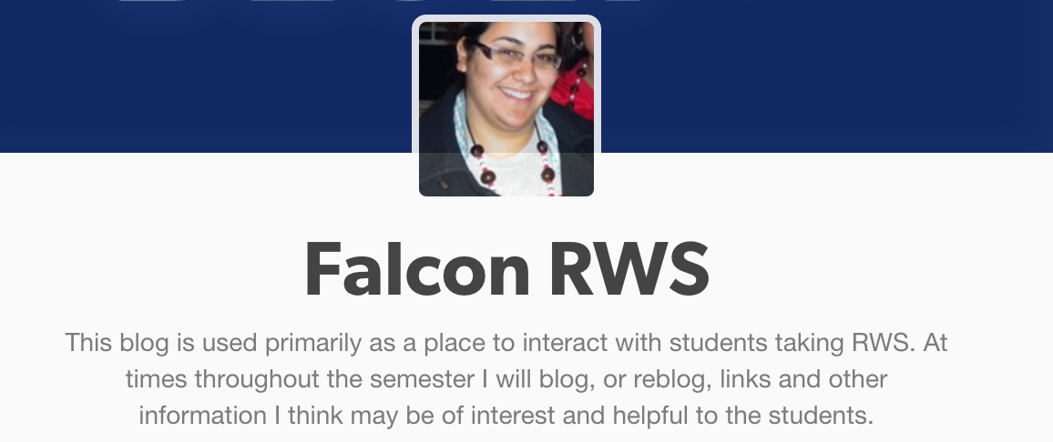
tumblr

Slide 8
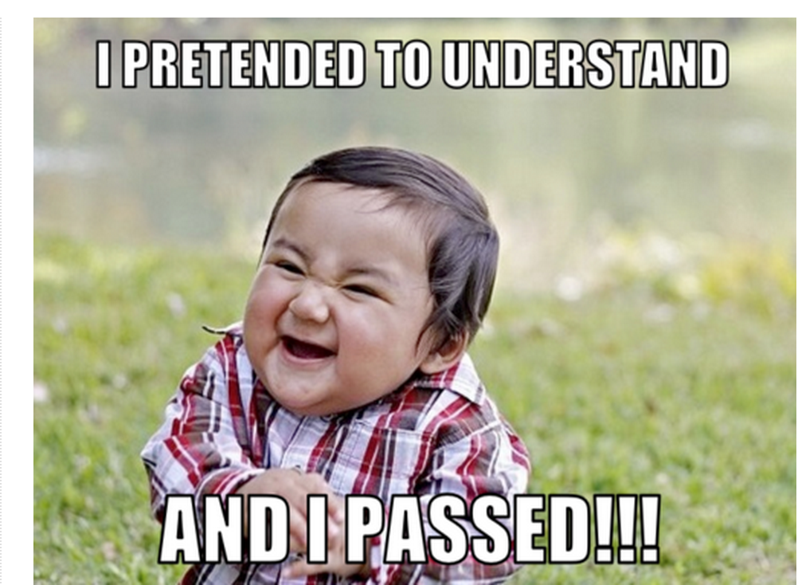
Student Examples

Slide 9
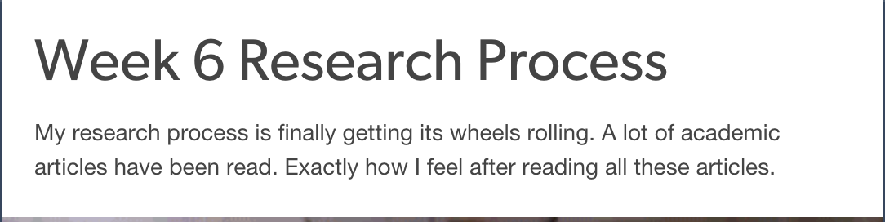

Student Examples

Slide 10
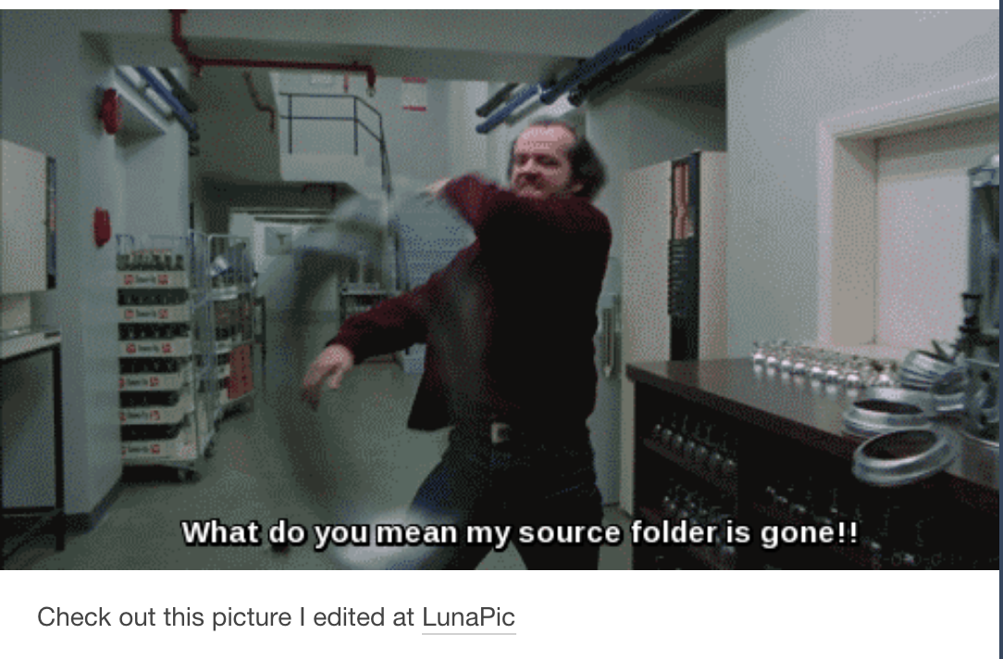
Student Examples

Slide 11
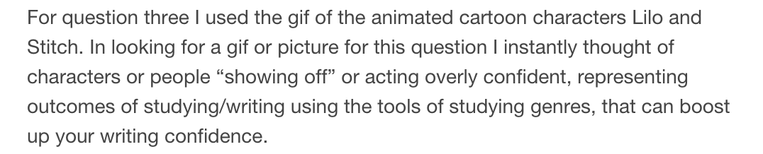
Student Examples

Slide 12
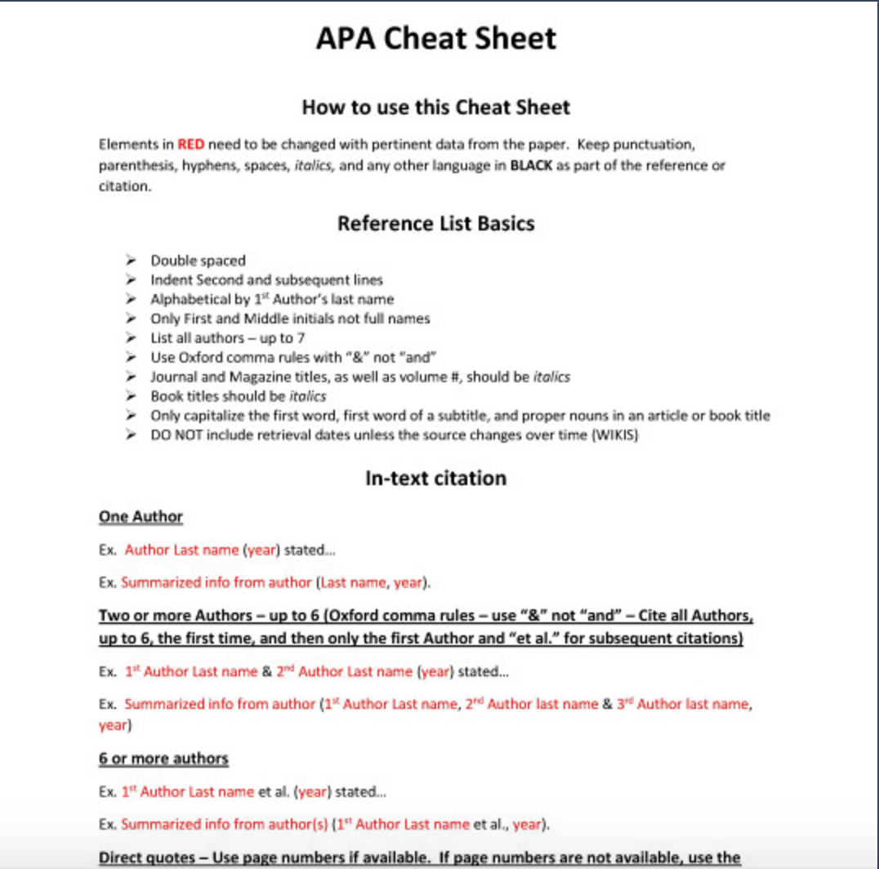
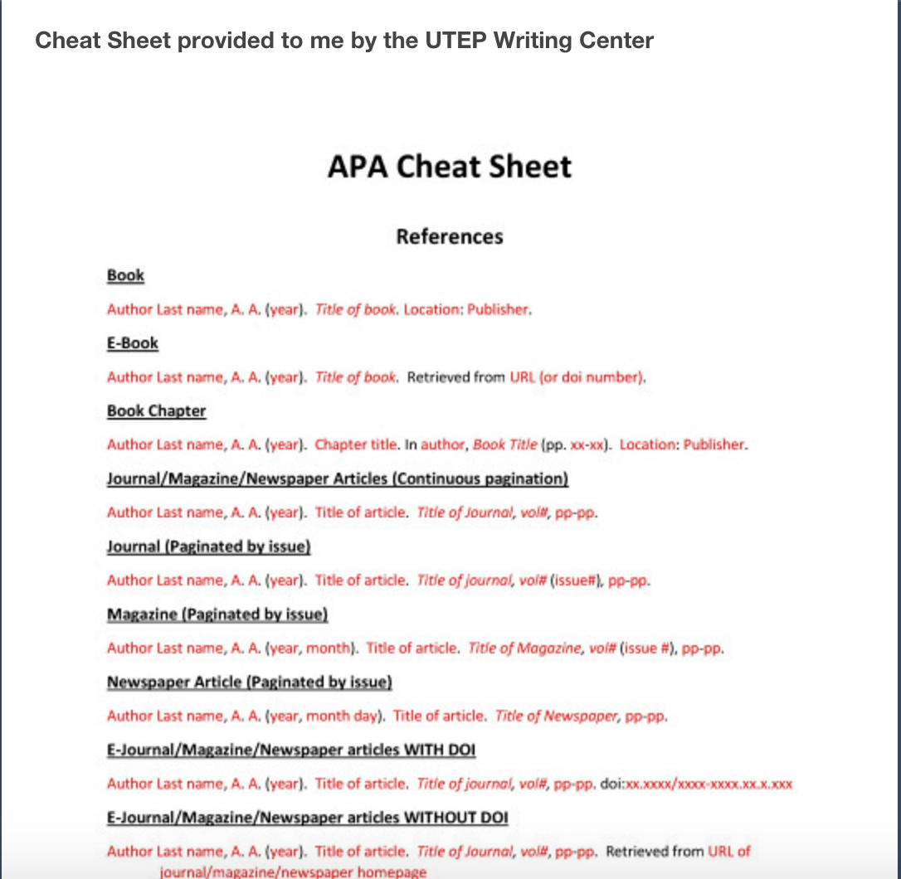
Student Examples

Slide 13
Advantages
Low stakes for student and instructor
Short multimodal composition
Gain insight to the process of the students
Hybrid, f2f, online

Slide 14
Disadvantages
Mimicry
Participation, reblog, like posts (notes) can be low
Students reluctant to share

Slide 15
References
Downing, K., Kwong, T., Chan, S. W., Lam, T. F., & Downing, W. K. (2009). Problem-based learning and the development of metacognition. Higher Education, 57(5), 609-621.
Hacker, D. J. (1998). Definitions and empirical foundations. Metacognition in educational theory and practice, 1-23.
New London Group. 1996. A pedagogy of multiliteracies: Designing social futures. Harvard Educational Review, 66: 60–92.
Selber , S. A. ( 2004 ). Multiliteracies for a digital age . Carbondale : Southern Illinois University Press
Yancey, Kathleen Blake, "Reflection in the Writing Classroom" (1998). All USU Press Publications. Book 120.

